Slide 1
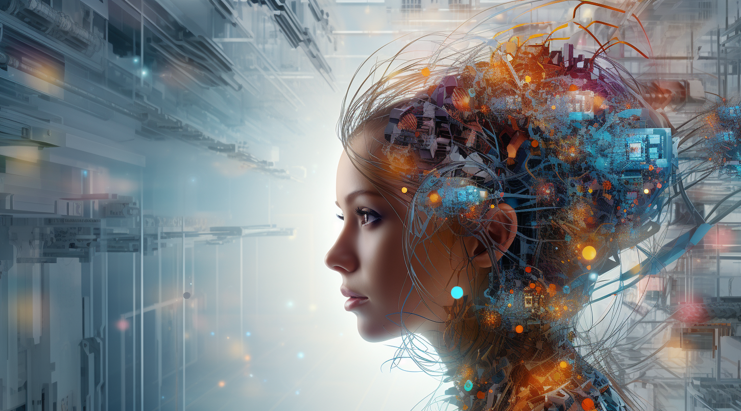
The AI age
Generative AIs and LLMs

Slide 2
What is Generative AI
Notes:
At its core, Generative AI is about algorithms that can create new content like writing text to creating images, music, and more.

Slide 3
What are LLMs
Notes:
Among the most groundbreaking advancements in Generative AI are Large Language Models, like OpenAI's GPT series. These models can generate coherent and contextually relevant text over long passages.

Slide 4
LLMs are used in Natural Language Processing

Slide 5
Chat GPT A Generative Pre-Trained Transformer
Notes:
At its core, Generative AI is about algorithms that can create new content like writing text to creating images, music, and more.

Slide 6
A sample Generative Architecture
Generator - generate data
Discriminator - distinguish between real and generated data

Slide 7
Transformer
Self-Attention
Paved way for LLMs

Slide 8
Pre-Trained
They are trained on a large data set

Slide 9
How do you understand language
Word Embedding (change to vector, categorisation for meaning)
Position encoding (grammers)
Various other encoding (relationships, other contexts etc)

Slide 10
“I did find the glass under the table but it was broken.”
Notes:
At its core, Generative AI is about algorithms that can create new content like writing text to creating images, music, and more.

Slide 11
Bird’s eye view of the process - input
Convert input
apply weights and calculate value
Encode value
Generate output

Slide 12
Bird’s eye view of the process - training
Convert training input
apply weights and calculate value
Encode values including the generated output
Plot and adjust weights

Slide 13
Bird’s eye view of the process - output
Get input, generate output
Generate values and convert to words
Send feedback and correct weights

Slide 14
Or in short
capture as much context - input
Develop a weight system - translator
translate and correct - output

Slide 15
Midjourney is a Generative AI with generator discriminator type network
Notes:
At its core, Generative AI is about algorithms that can create new content like writing text to creating images, music, and more.

Slide 16
“A well-crafted prompt bridges boundless data with purposeful creation."
- chatgpt

Slide 17
Prompt is key

Slide 18
A good prompt ..
Is Clear - practice and then prompt
Is Concise - save tokens
Sets Roles - instead of context
is explicit - assume nothing

Slide 19
A good prompt ..
Is iterative in nature
Has examples
Has parameters - temperature and max tokens
Avoid Bias

Slide 20
You are an expert UI developer and author code which adhere to the atomic design principles as well as BEM naming conventions…

Slide 21
Provide me with the HTML, CSS and JS for the following instructions: The page has 3 rows, each containing the following full width components in the mentioned order - a login component, a search component and a footer menu component

Slide 22
“The more you learn, the better your prompt."
- experience

Slide 23
Thanks!
Mail: supi@27technologies.com

